Slide 1

FinFET & FD-SOI Technologies
[116] Design of VLSI Systems
Group 02: Antonios KAPETANIOS [10417] and Panagiotis PAPADOPOULOS [10697]
5 November 2025

Slide 2
Contents
Introduction
FinFET
  Introduction
  Architecture
  Different Structures
  Performance Benefits
  Challenges and Limitations
FD-SOI
  Technology overview
  “A Novel 1T-APS Using 22nm FD-SOI Technology With Record High Tunable Sensitivity Range”, H. Xie et al. [3]
  “A Wideband Sub-6GHz Transceiver Front End for 5G Base Stations in 22-nm FD-SOI CMOS”, C. Elgaard et al. [4]
References

Slide 3
FinFET
Technology overview
“Comprehensive Review of FinFET Technology: History, Structure, Challenges, Innovations, and Emerging Sensing Applications”, K. Karimi et al. [1]
“FinFET to GAA MBCFET: A Review and Insights”, R. R. Das et al. [2]

Slide 4
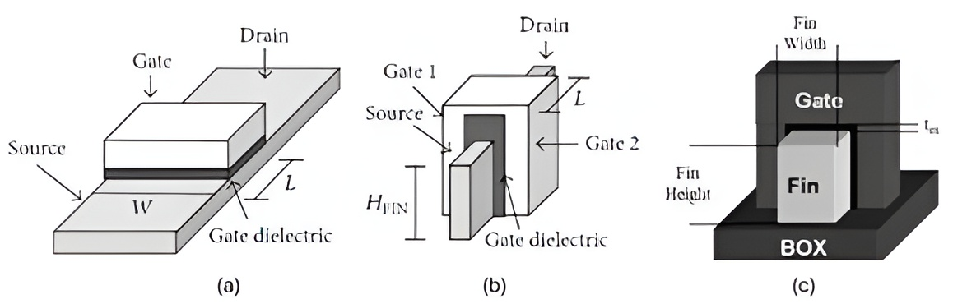
Introduction to FinFET Technology
FinFET = Three-dimensional multi-gate MOSFET
Developed to overcome short-channel effects in planar CMOS
Introduced ~2000 by C. Hu (Berkeley)
Enables continued CMOS scaling below 32 nm
Figure FinFET.1: Structure Schematic of (a) planar MOSFET and (b) FinFET. (c) Demonstrating HFin as fin height and WFin as fin width. Figure taken from Karimi, K.; Fardoost, A.;Javanmard, M. Comprehensive, Review of FinFET Technology: History, Structure, Challenges, Innovations, and Emerging Sensing Applications. Micromachines 2024, 15, 1187.

Slide 5
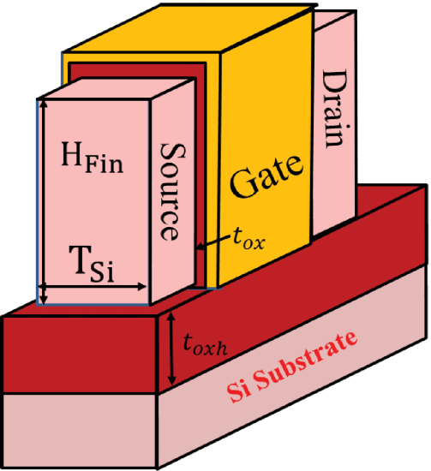
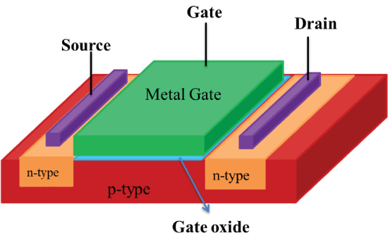
Motivation: Limitations of Planar MOSFETs
At < 32nm: strong SCE, leakage currents ↑, threshold voltage variation ↑
Gate control weak → poor electrostatics and power inefficiency
Need for multi-gate structures (MuGFETs)
Figure FinFET.2: The planar MOSFET semiconductor device.
Figure FinFET.3: Schematic diagram of conventional FinFET.
Figures taken from R. R. Das, T. R. Rajalekshmi and A. James, "FinFET to GAA MBCFET: A Review and Insights," in IEEE Access, vol. 12, pp. 50556-50577, 2024, doi: 10.1109/ACCESS.2024.3384428.

Slide 6
Historical Development
Vaccum Tube
Design of Insulated-Gate Field Effect Transistor (aka MOSFET)
Fabrication of first quasi planar FinFET device
1948
1958
1904
1956
2001
Invention of Bipolar Junction Transistor
Development of First Integrated Circuit

Slide 7
FinFET
Technology overview
“Comprehensive Review of FinFET Technology: History, Structure, Challenges, Innovations, and Emerging Sensing Applications”, K. Karimi et al. [1]
“FinFET to GAA MBCFET: A Review and Insights”, R. R. Das et al. [2]

Slide 8
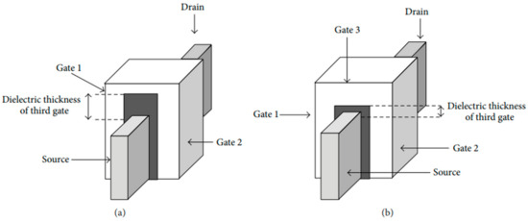
FinFET Structure and Operating Principle
Vertical "fin" channel with gate on three sides (tri-gate)
HFin (fin height) controls drive current
WFin (fin width) controls electrostatics
Better channel control → lower leakage
Figure FinFET.4: Schematic of (a) DG FinFET and (b) tri-gate FinFET. Figure taken from Karimi, K.; Fardoost, A.;Javanmard, M. Comprehensive, Review of FinFET Technology: History, Structure, Challenges, Innovations, and Emerging Sensing Applications. Micromachines 2024, 15, 1187.

Slide 9
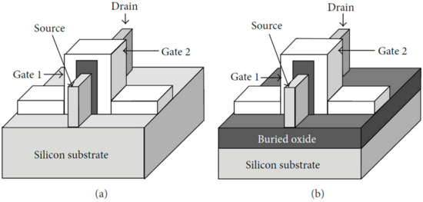
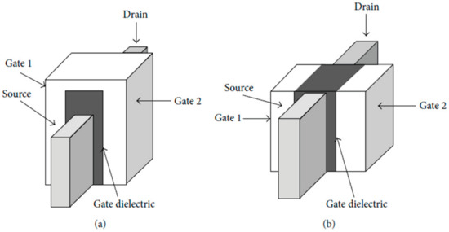
FinFET Classifications
Figure FinFET.5: Structure schematic of (a) Bulk FinFET and (b) SOI FinFET
By substrate: Bulk vs SOI FinFET (Fig. 5)
By gate type: Short-Gate (3-terminal) vs Independent Gate (4-terminal) (Fig. 6)
By dielectric geometry: Double-Gate vs Tri-Gate (Fig. 4)
Tri-Gate = lower capacitance + better performance
Figure FinFET.6: Structure schematic of (a) SG FinFET and (b) IG FinFET
Figure FinFET.4: Schematic of (a) DG FinFET and (b) tri-gate FinFET.
Figure 4 reused for FinFET Classification.
Figures taken from Karimi, K.; Fardoost, A.;Javanmard, M. Comprehensive, Review of FinFET Technology: History, Structure, Challenges, Innovations, and Emerging Sensing Applications. Micromachines 2024, 15, 1187.

Slide 10
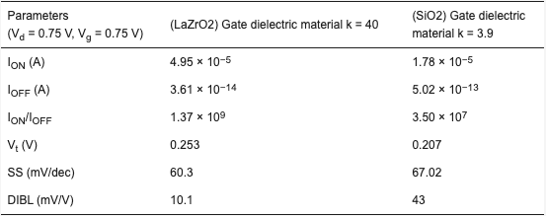
Materials in FinFET Fabrication
Gate dielectrics: HfO₂, LaZrO₂ → high-k, low leakage
Channel materials: Si, SiGe, GaAs, GaN → mobility ↑
LaZrO₂ FinFET: Ion/Ioff ≈ 1.37 × 10⁹ vs 3.5 × 10⁷ for SiO₂
HKMG stacks → better Vt stability
Table FinFET.1: The impact of SiO2 and LaZrO2 gate dielectric material usage in n-FinFET device efficiency. Table taken from Karimi, K.; Fardoost, A.;Javanmard, M. Comprehensive, Review of FinFET Technology: History, Structure, Challenges, Innovations, and Emerging Sensing Applications. Micromachines 2024, 15, 1187.

Slide 11
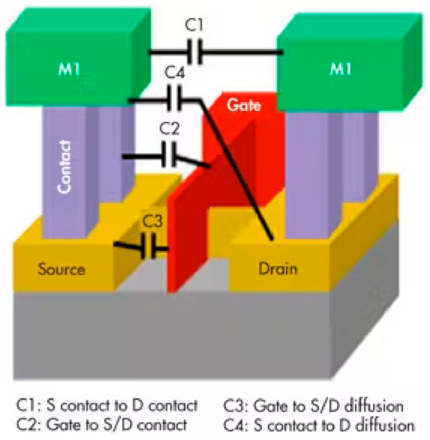
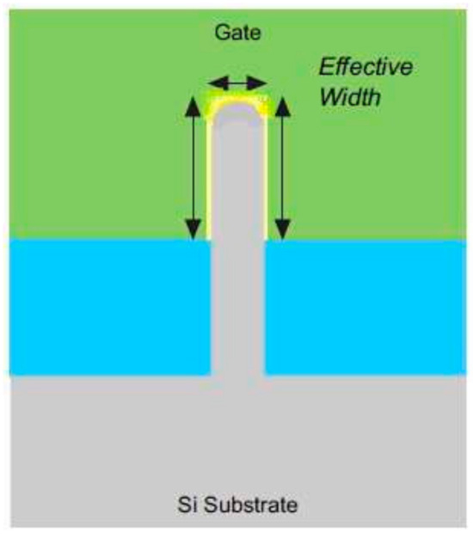
Key Challenges
Parasitic capacitances ↑ → slower switching
Corner leakage → “corner effects”
Quantum effects → mobility loss in ultra-thin fins
Complex lithography and self-heating
Figure FinFET.7: Parasitic capacitances of a FinFET
Figure FinFET.8: Cross-sectional view of a Tri-FinFET with curved fin corners
Figures taken from Karimi, K.; Fardoost, A.;Javanmard, M. Comprehensive, Review of FinFET Technology: History, Structure, Challenges, Innovations, and Emerging Sensing Applications. Micromachines 2024, 15, 1187.

Slide 12
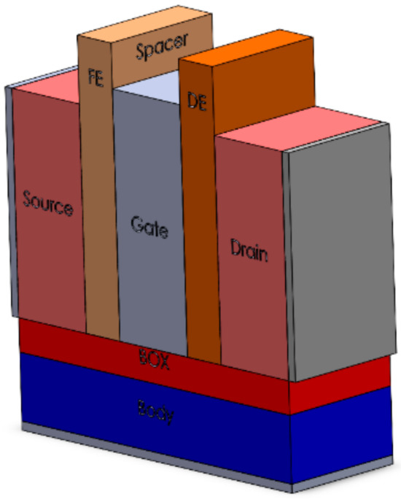
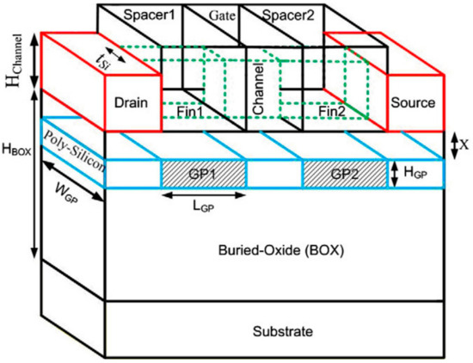
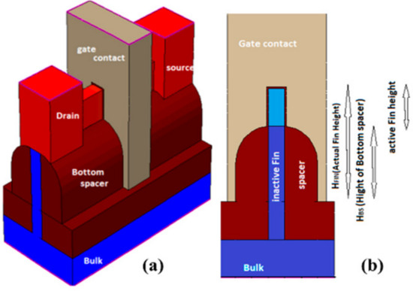
Recent Innovations
Ground-Plane FinFET (GP-FinFET): lower DIBL
Bottom-Spacer FinFET: better SCE & thermal control
Negative Capacitance FinFET: ferroelectric spacer → higher Ion, lower SS
Figure FinFET.9: Three-dimensional view of the GP-FinFET structure schematic
Figure FinFET.10: Three-dimensional view of the most effective structure of Negative Capacitance FinFET with Ferroelectric Spacer
Figure FinFET.11: (a) 3D view and (b) side view of the structure of bottom spacer FinFET
Figures taken from Karimi, K.; Fardoost, A.;Javanmard, M. Comprehensive, Review of FinFET Technology: History, Structure, Challenges, Innovations, and Emerging Sensing Applications. Micromachines 2024, 15, 1187.

Slide 13
Conclusion
FinFET = key bridge between planar CMOS and GAA
Provides low power and scalability down to ≈ 5 nm
Remaining issues: thermal management, manufacturing cost
Next step → GAA (Multi-Bridge Channel FET)

Slide 14
FinFET
Technology overview
“Comprehensive Review of FinFET Technology: History, Structure, Challenges, Innovations, and Emerging Sensing Applications”, K. Karimi et al. [1]
“FinFET to GAA MBCFET: A Review and Insights”, R. R. Das et al. [2]

Slide 15
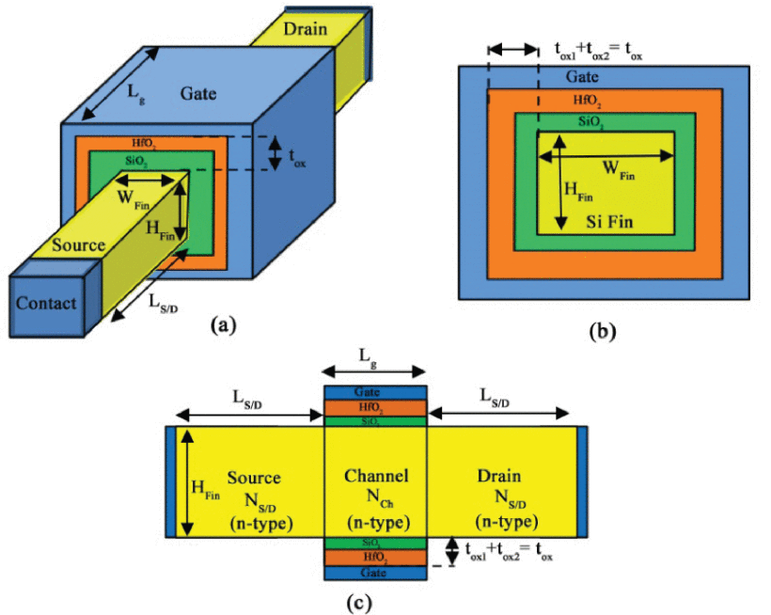
Introduction to Gate-All-Around (GAA)
GAA: channel fully surrounded by gate → 360° control
Better suppression of SCE and DIBL
Improved sub-threshold swing and mobility
Compatible with existing FinFET fabrication flow
Figure FinFET.12: Schematic diagram of GAA structure along (a) Vertical and
horizontal view (b) & (c). Figure taken from R. R. Das, T. R. Rajalekshmi and A. James, "FinFET to GAA MBCFET: A Review and Insights," in IEEE Access, vol. 12, pp. 50556-50577, 2024, doi: 10.1109/ACCESS.2024.3384428.

Slide 16
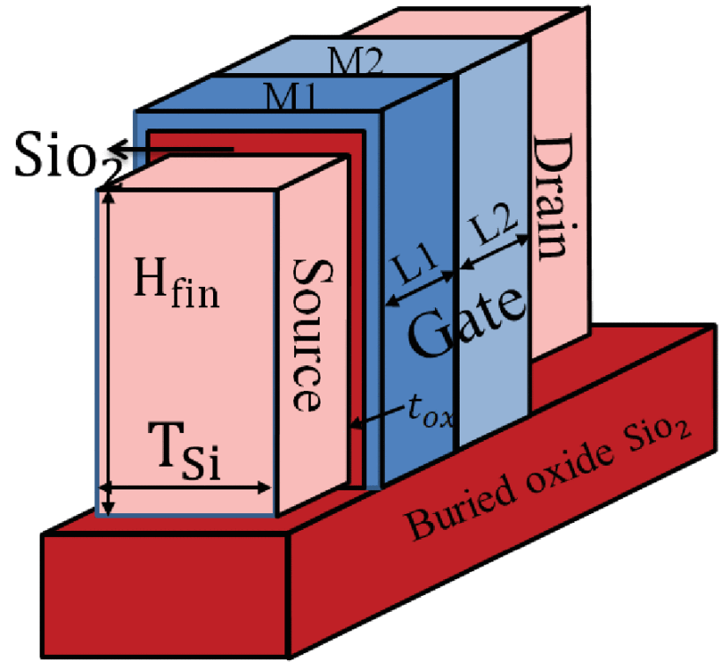
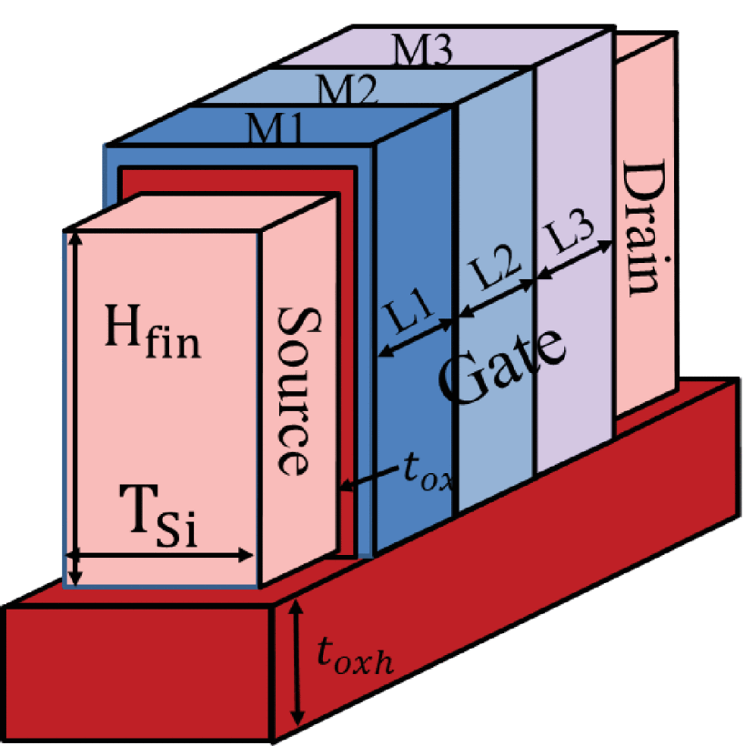
Motivation for GAA Evolution
FinFET scaling limited beyond 5 nm → electrostatics degrade
Fin height & width quantization → reduced control
GAA offers full gate wrapping → stronger channel coupling
Enables continued Moore’s Law scaling
Figure FinFET.13: Schematic diagram of DMG FinFET
Figure FinFET.14: Schematic diagram of TMG FinFET
Figures taken from R. R. Das, T. R. Rajalekshmi and A. James, "FinFET to GAA MBCFET: A Review and Insights," in IEEE Access, vol. 12, pp. 50556-50577, 2024, doi: 10.1109/ACCESS.2024.3384428.

Slide 17
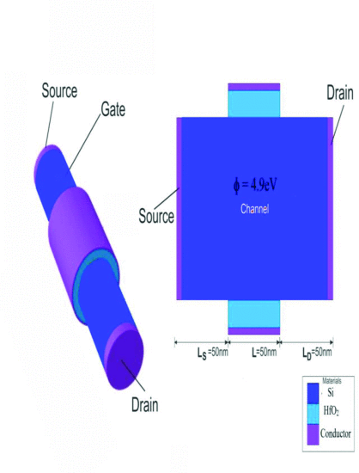
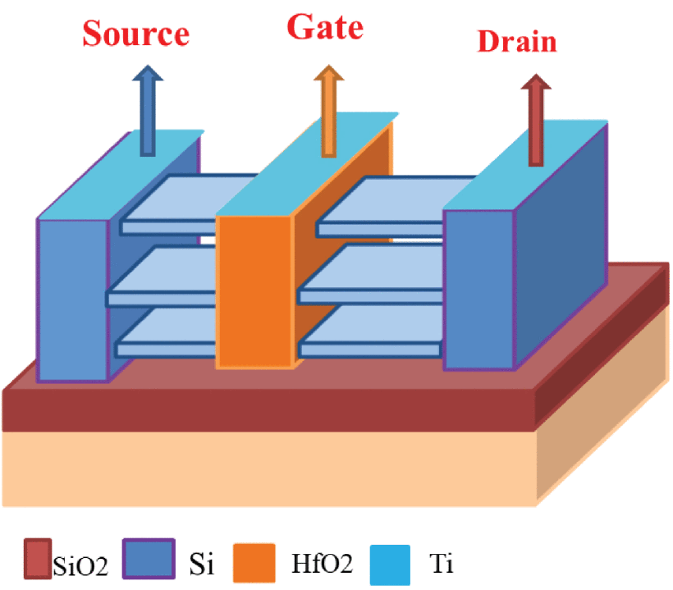
From Nanowires to Nanosheets
Early GAAs used nanowires → excellent control but low drive current
Nanosheets (MBCFETs) widen the channel → higher Ion
Multi-Bridge structure = stacked nanosheets
Samsung first adopted MBCFET for 3 nm node (2022)
Figure FinFET.15: Cross Sectional and Schematic view of Nanowire FET. Figure taken from M. Singh, Harsh, M. Rani, P. Mittal, T. Chaudhary and B. Raj, "Nanowire FET Design and Analysis for Low-Power Applications," 2025 International Conference on Electronics, AI and Computing (EAIC), Jalandhar, India, 2025, pp. 1-5, doi: 10.1109/EAIC66483.2025.11101388.
Figure FinFET.16: Cross Sectional and Schematic view of Nanowire FET. Figure taken from R. R. Das, T. R. Rajalekshmi and A. James, "FinFET to GAA MBCFET: A Review and Insights," in IEEE Access, vol. 12, pp. 50556-50577, 2024, doi: 10.1109/ACCESS.2024.3384428.

Slide 18
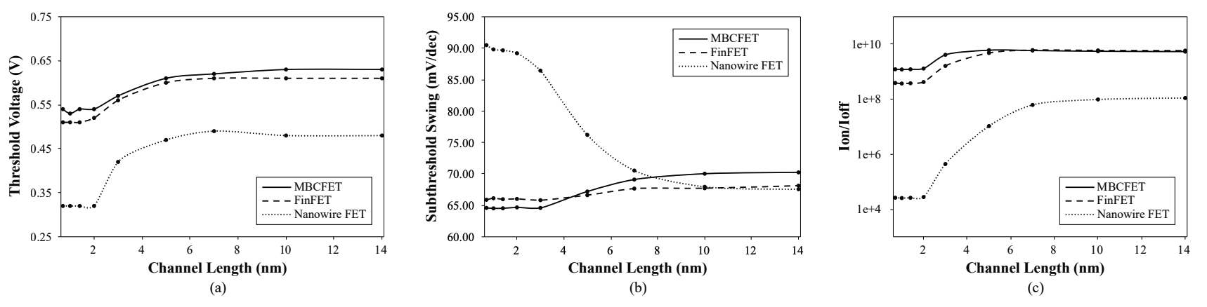
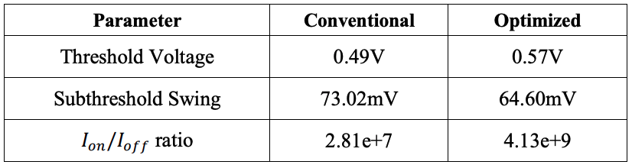
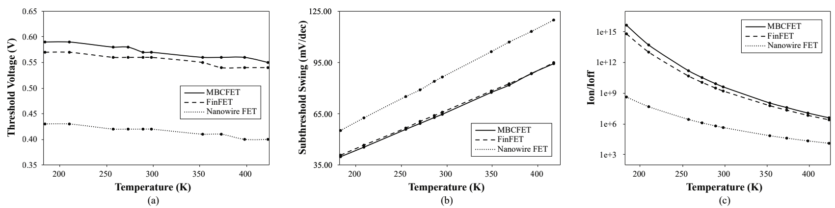
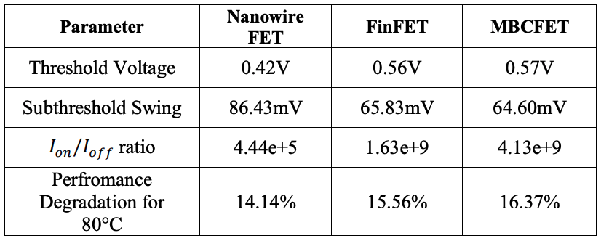
FinFETs VS GAA MBCFETS
Figure FinFET.17.2: Performance comparison.
Figure FinFET.17.1: Effect of Channel Length on (a) Threshold Voltage (b) Subthreshold Swing (c) Ion/Ioff ratio.
Figures FinFET.18.2: Performance comparison.
Figures FinFET.18.1: Effect of Temperature on (a) Threshold Voltage (b) Subthreshold Swing (c) Ion/Ioff ratio.
Figures taken from Ahmed, Foez & Paul, Robi & Saha, J.. (2020). Comparative Performance Analysis of TMD based Multi-Bridge Channel Field Effect Transistor. 10.1109/NAP51477.2020.9309688 [9]

Slide 19
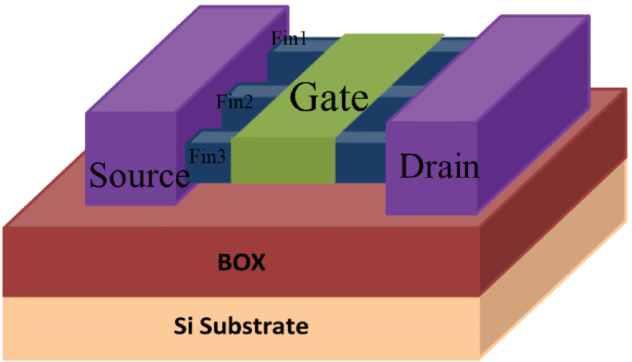
FinFETs VS GAA MBCFETS
FOOTPRINT AREA AND SPEED
  M-FinFET ↑ area/fin, GAA MBCFET ↑channels, = area.
INTERNAL STRUCTURE
  Dynamically alter the channel width, which is a functionality absent in traditional FinFETs
PRODUCTION
  Identical process tools & manufacturing procedures →Seamless integration
LOW LEAKAGE CURRENTS, OPERATIONAL VOLTAGE, AND DYNAMIC POWER
  GAA →electrostatic gate control capacity ↑, leakage ↓
  GAAFETs →scalability & gate control, FinFETs →low power
  Combination: Voltage scaling and adaptive body biasing
Figure FinFET.19: Schematic diagram of M-FinFET. Figure taken from R. R. Das, T. R. Rajalekshmi and A. James, "FinFET to GAA MBCFET: A Review and Insights," in IEEE Access, vol. 12, pp. 50556-50577, 2024, doi: 10.1109/ACCESS.2024.3384428.

Slide 20
Where the Industry Stands Today
Company | Current Node (2024-2025) | Next-Gen Target | Technology in Use | Adoption Timeline
Samsung | 3 nm (3GAE / 3GAP) – world’s first GAA MBCFET chips (since 2022)[10] | 2 nm GAA MBCFET | GAA MBCFET (3 nm) + FinFET legacy nodes | First gen GAA → 2022 2nd gen → 2023 2 nm planned 2025
TSMC | 3 nm FinFET (N3 series) [11] | 2 nm GAA Nanosheet (N2) | FinFET | Developing GAA for ~2026 launch
Intel | Intel 4 / Intel 3 FinFET | 2 nm “Intel 20A” = RibbonFET (GAA) [12] | FinFET | GAA introduction ~2024 (20A node)

Slide 21
FD-SOI
Technology overview
“A Novel 1T-APS Using 22nm FD-SOI Technology With Record High Tunable Sensitivity Range”, H. Xie et al. [3]
“A Wideband Sub-6GHz Transceiver Front End for 5G Base Stations in 22-nm FD-SOI CMOS”, C. Elgaard et al. [4]

Slide 22
FD-SOI
Technology overview
“A Novel 1T-APS Using 22nm FD-SOI Technology With Record High Tunable Sensitivity Range”, H. Xie et al. [3]
“A Wideband Sub-6GHz Transceiver Front End for 5G Base Stations in 22-nm FD-SOI CMOS”, C. Elgaard et al. [4]

Slide 23
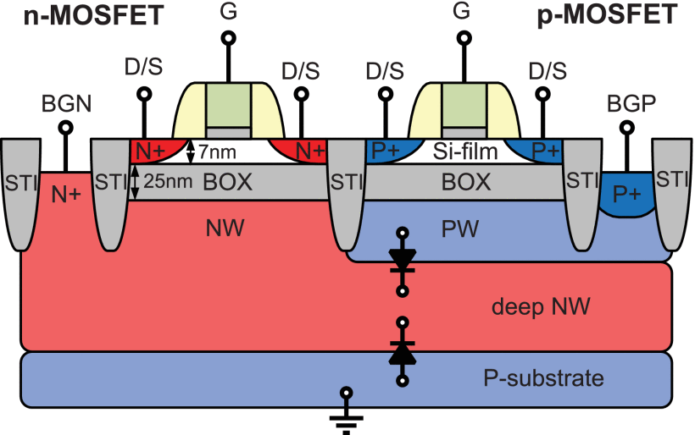
Fully Depleted-Silicon On Insulator: Overview
Thin Si channel (body) depleted of free carriers
Back-gate control [5][6][8]
Reduced [5]:
  Junction capacitance
  Leakage current
  Power consumption
  Output conductance
Increased:
  Transconductance [5]
  Intrinsic voltage gain
Figure FD-SOI.1: Cross-section of the n- and p-channel MOSFETs with back-gate wells and deep n-well in 28nm UTBB FD-SOI CMOS process [13] .
Notes:
Great for 5G millimeter-wave applications [https://doi.org/10.1016/B978-0-12-822823-4.00002-9]
Μηχανισμός λειτουργίας

Slide 24
FD-SOI
Technology overview
“A Novel 1T-APS Using 22nm FD-SOI Technology With Record High Tunable Sensitivity Range”, H. Xie et al. [3]
“A Wideband Sub-6GHz Transceiver Front End for 5G Base Stations in 22-nm FD-SOI CMOS”, C. Elgaard et al. [4]

Slide 25
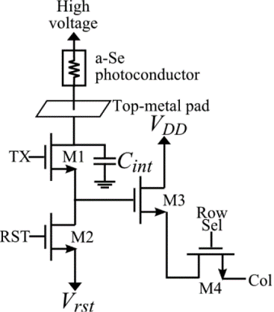
1T-APS Using 22nm FD-SOI Technology
Figure FD-SOI.3: Typical CMOS 4T-APS (four-transistor active pixel sensor). Taken from [7].
Figure FD-SOI.4: Equivalent circuit of the 1T-APS in FD-SOI 22nm proposed by [3].
Notes:
Αρχή λειτουργίας 4T-APS

Slide 26
FD-SOI
Technology overview
“A Novel 1T-APS Using 22nm FD-SOI Technology With Record High Tunable Sensitivity Range”, H. Xie et al. [3]
“A Wideband Sub-6GHz Transceiver Front End for 5G Base Stations in 22-nm FD-SOI CMOS”, C. Elgaard et al. [4]

Slide 27
Rx Front-End: Low Noise Amplifier (LNA)
Fully differential structure
Source degeneration for and (input pair)
Reactive feedback using transformers for improved:
  Bandwidth
  Low additional noise
resonates with the output-node capacitances
Figure FD-SOI.X: CMOS LNA schematic [4].

Slide 28
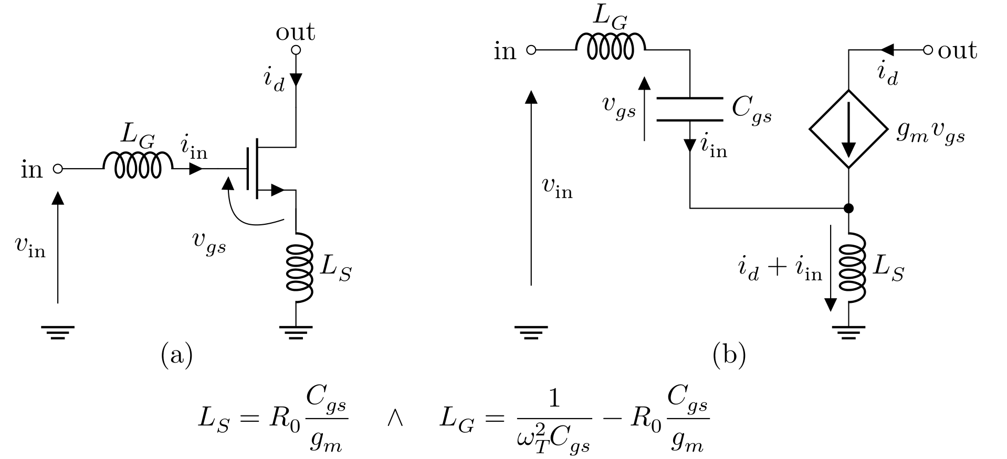
CS Amplifier: Source Degeneration
Figure FD-SOI.X: (a) Common source (CS) nMOS. The CS amplifier is preceded by a system with output impedance . (b) shows the small-signal equivalent of (a).

Slide 29
References
[1] Author A, Author B, Author C. “Article title”. Journal title. YYYY, pp. XXX- XXX. DOI: 10.1109/ISCIT.2006.339951.
[2] Author A, Author B, Author C. “Article title”. Journal title. YYYY, pp. XXX– XXX. DOI: 10.3390/mi14020320.
[3] H. Xie, Z. Wang, R. He, et al., “A Novel 1T-APSUsing 22nm FD- SOI Technology With Record High Tunable Sensitivity Range,” IEEE Electron Device Letters, Vol. 46, No. 7, pp. 1131–1134, Jul. 2025, ISSN: 1558- 0563. DOI: 10.1109/LED.2025.3563988.
[4] C. Elgaard, M. Abdulaziz, T. Påhlsson, et al., “A Wideband Sub-6GHz Transceiver Front End for 5G Base Stations in 22-nm FD-SOI CMOS,” IEEE Journal of Solid-State Circuits, Vol. 60, No. 7, pp. 2367–2383, Jul. 2025 ISSN: 1558-173X. DOI: 10.1109/JSSC.2025.3552278.

Slide 30
[5] L. Nyssens, M. Rack, and J.-P. Raskin, “Chapter 2 - FD-SOI and RF-SOI Technologies For 5G,” in New Materials and Devices Enabling 5G Applications and Beyond, ser. Materials Today, N. Collaert, Ed., Elsevier, 2024, pp. 33–55, ISBN: 978-0-12-822823-4. DOI: 10.1016/B978-0-12-822823-4.00002-9. [Online].
[6] Georges Pananakakis, Gérard Ghibaudo, Sorin Cristoloveanu. “Threshold voltage in FD-SOI MOSFETs”. Solid-State Electronics, Vol. 217, 2024. DOI: 10.1016/j.sse.2024.108947.
[7] Parsafar, Alireza, Scott, Christopher C., El-Falou, Abdallah, Levine, Peter M., Karim, Karim S.. “Direct-Conversion CMOS X-Ray Imager With 5.6 μm × 5.6 μm Pixels”. IEEE Electron Device Letters. 2015, pp. 481-483. DOI: 10.1109/LED.2015.2410304.
[8] Liu, Q. and Yagishita, A., Loubet, N., Khakifirooz, A., Kulkarni, P., Yamamoto, T., Cheng, K., Fujiwara, M., Cai, J., Dorman, D., Mehta, S., Khare, P. and Yako, K., Zhu, Y., Mignot, S., Kanakasabapathy, S., Monfray, S., Boeuf, F., Koburger, C.,Sunamura, H., Ponoth, S., Reznicek, A., Haran, B., Upham, A., Johnson, R., Edge, L. F., Kuss, J., Levin, T., Berliner, N., Leobandung, E., Skotnicki, T., Hane, M., Bu, H., Ishimaru, K., Kleemeier, W., Takayanagi, M., Doris, B., Sampson, R.. “Ultra-thin-body and BOX (UTBB) fully depleted (FD) device integration for 22nm node and beyond”. 2010 Symposium on VLSI Technology. 2010, pp. 61-62. DOI: 10.1109/VLSIT.2010.5556120.

Slide 31
[9] Ahmed, Foez & Paul, Robi & Saha, J.. “Comparative Performance Analysis of TMD based Multi-Bridge Channel Field Effect Transistor”. 2020 IEEE 10th International Conference Nanomaterials: Applications & Properties (NAP). 2020, pp. 01TPNS04-1- 01TPNS04-5. DOI: 10.1109/NAP51477.2020.9309688.
[10] https://semiconductor.samsung.com/processor/mobile-processor/
[11] https://www.tsmc.com/english/dedicatedFoundry/technology/logic
[12] https://www.intel.com/content/www/us/en/foundry/process.html
[13] Shopov, Stefan and Voinigescu, Sorin P.. “A 3×60Gb/s Transmitter/Repeater Front- End With 4.3V_{PP} Single-Ended Output Swing in a 28nm UTBB FD-SOI Technology”. IEEE Journal of Solid-State Circuits, Vol. 51. 2016, pp. 1651-1662. DOI: 10.1109/JSSC.2016.2545703.

